Slide 1
Promoting good practice in tackling poverty and disadvantage INSET materials for secondary schools

Slide 2
Part 1: What do we know about disadvantaged pupils?

Slide 3
Slide 1: Overall aims of the training:
The overall aims of the training are to promote best practice in tackling poverty and disadvantage as well as support schools in developing a whole-school structured, coherent and focused approach to raising the achievement of disadvantaged pupils.
Objectives for participants:
By the end of this session, participants will have:
considered the characteristics and impact of poverty and disadvantage on pupils; and
reflected on how pupils in the school are affected by disadvantage.
Outcomes for participants:
By the end of this session, participants should:
understand how poverty and disadvantage impact on their pupils’ achievements and progress; and
know the school priorities for tackling disadvantage identified in the school improvement plan.

Slide 4
Slide 2: How should we define disadvantaged pupils?
It is important to have a broad range of criteria for identifying disadvantaged pupils. Disadvantaged pupils include:
• those eligible for free school meals;
• those from minority groups;
• those in families on low income;
• looked-after children; and
• traveller children.

Slide 5
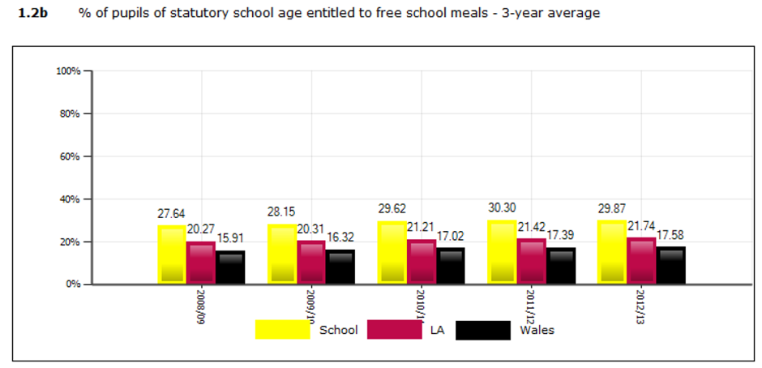
Slide 3: The school’s percentage of
statutory school age pupils entitled to FSM –
three year average
You should insert chart 1.2b from the school’s All Wales core data set. The following chart shows an example of this table.

Slide 6
Slide 4: Studies on child poverty
tell us that:
• the gap between pupils from richer and poorer backgrounds widens especially quickly during primary school;
• disadvantaged pupils in primary schools are more likely to lack ambition and self esteem, and to have behavioural problems and difficulty relating to their peers;
• boys as young as nine in disadvantaged schools become disenchanted with school and start to disengage; and
• pupils in disadvantaged schools have limited access to music, art and out of school activities that pupils in advantaged schools generally take for granted.

Slide 7
Slide 5: We also know that pupils
from disadvantaged backgrounds:
are more likely to have a poor attendance record;
often perceive the curriculum as irrelevant;
are less likely to accept the school culture;
are more likely to have additional learning needs;
have parents who are less likely to be involved in their children’s education;
have parents who are more likely to have a negative perception and experience of school and education; are less healthy;
are more likely to be not in employment, education or training;
are more likely to have a child in their teenage years; and
in the case of white working class boys, are less likely to achieve their potential than any other group

Slide 8
Slide 6: Research also tells us that disadvantaged pupils are more likely to do well at GCSE if the young person:
has a belief in …;
believes that …;
finds school …;
thinks it is likely that …;
avoids …; and
does not experience ….

Slide 9
Slide 6 (completed): Research also tells us that disadvantaged pupils are more likely to do well at GCSE if the young person:
has a belief in his/her own ability at school;
believes that events result primarily from his/her own behaviour and actions;
finds school worthwhile;
thinks it is likely that he/she will apply to, and get into, higher education;
avoids risky behaviour such as frequent smoking, cannabis use, anti-social behaviour, truancy, suspension and exclusion; and
does not experience bullying.

Slide 10
Slide 7: The school’s current priorities for tackling disadvantage include:
• …
• …
• …
• …
(You should complete this slide with information taken from the school improvement plan.)

Slide 11
Part 2: How well are our disadvantaged pupils achieving?

Slide 12
Revision of Part 1
How have we defined disadvantaged pupils?
It is important to have a broad range of criteria for identifying disadvantaged pupils. Disadvantaged pupils include:
• those entitled to free school meals;
• those from minority groups;
• those in families on low income;
• looked-after children; and
• traveller children.

Slide 13
Revision of Part 1
What do we know about the effects of poverty and disadvantage?
Disadvantaged pupils are more likely to lack ambition and self-esteem, and to have behavioural problems and difficulty relating to their peers.
Disadvantaged pupils are more likely to see the curriculum as irrelevant.
Pupils in disadvantaged schools have limited access to music, art and out-of-school activities that pupils in advantaged schools generally take for granted.
Pupils from disadvantaged backgrounds are more likely to have a poor attendance record and are often less likely to accept the school culture.
Pupils from disadvantaged backgrounds are more likely to be not in employment, education or training. They are also are more likely to have a child in their teenage years.
Pupils from disadvantaged backgrounds are more likely to have parents who are less involved in their children’s education and have a negative perception and experience of school and education.

Slide 14
Slide 1: Objectives for participants:
By the end of this session, participants will have:
explored a range of national and local data on the performance of disadvantaged pupils; and
considered the performance of disadvantaged pupils in the school at key stage 3 and key stage 4.
Outcomes for participants:
By the end of this session, participants should:
know about the performance of disadvantaged pupils in Wales; and
understand how well disadvantaged pupils are achieving in the school.

Slide 15
Slide 2: Key results for disadvantaged pupils
in Wales
• Overall, the performance of both FSM and non-FSM pupils has improved since 2005. Looking at the core subject indicator, the gap in performance has generally narrowed over the last six years at key stage 3.
• However, the performance of pupils entitled to FSM is lower than their non entitled counterparts at all key stages and in all performance measures. The gap in performance increases as pupils get older.
• In key stage 3, for individual subjects, the gap is widest in mathematics (23.1 percentage points) although historically it has been widest in English. The gap is narrowest in Welsh (17.8 percentage points).
• At key stage 4, the gap is now widest for the core subject indicator (32.1 percentage points) although historically it has been wider at the L2 threshold. The gap is narrowest at the L1 threshold (10.6 percentage points).
• There are ‘gaps’ in performance between learner groups such as looked-after children compared with all pupils: 10% attain the expected level in secondary school compared with 50% for all pupils.

Slide 16
Slide 3: Key results for
disadvantaged pupils in Wales in key stage 3
Difference between CSI performance of FSM and non-FSM pupils at key stage 3, 2008-2013

Slide 17
Slide 4: Key results for
disadvantaged pupils in Wales in key stage 4
Difference between performance in the Level 2 threshold including a GCSE A*-C in English / Welsh and mathematics of FSM and non-FSM pupils at key stage 4, 2008-2013

Slide 18
Slide 5: Key stage 3 – school performance data
(Insert data from Section 1.2a/1.2b (FSM/non-FSM trend and family comparison) from the All Wales core data set for key stage 3.)

Slide 19
Slide 6: Key stage 4 – school performance data
(Insert data from Section1.4a/1.4b (FSM/non-FSM trend and family comparison) from the All Wales core data set for key stage 4.)

Slide 20
Slide 7
Insert your own data on the performance of disadvantaged pupils, such as value-added data.

Slide 21
Part 3: What do effective schools in challenging circumstances do well?

Slide 22
Revision of Parts 1 and 2
How have we defined disadvantaged pupils?
It is important to have a broad range of criteria for identifying disadvantaged pupils. Disadvantaged pupils include:
• those entitled to free school meals;
• those from minority groups;
• those in families on low income;
• looked-after children; and
• traveller children.

Slide 23
Revision of Parts 1 and 2
What do we know about the effects of poverty and disadvantage?
Disadvantaged pupils are more likely to lack ambition and self-esteem, and to have behavioural problems and difficulty relating to their peers.
Disadvantaged pupils are more likely to see the curriculum as irrelevant.
Pupils in disadvantaged schools have limited access to music, art and out-of-school activities that pupils in advantaged schools generally take for granted.
Pupils from disadvantaged backgrounds are more likely to have a poor attendance record and are often less likely to accept the school culture.
Pupils from disadvantaged backgrounds are more likely to be not in employment, education or training. They are also are more likely to have a child in their teenage years.
Pupils from disadvantaged backgrounds are more likely to have parents who are less involved in their children’s education and have a negative perception and experience of school and education.

Slide 24
Slide 1: Objectives for participants:
By the end of this session, participants will have:
• reflected on good practice in the provision for disadvantaged pupils; and
• evaluated aspects of the school’s provision for disadvantaged pupils.
Outcomes for participants:
By the end of this session, participants should have identified:
• strengths in the school’s provision for disadvantaged pupils; and
• areas for improvement in order to raise the standards of disadvantaged pupils’ achievements.

Slide 25
Slide 2: Strategies that can be implemented by the school alone
Ten in-school strategies:
Whole-school approach
Using data to identify and track progress
Literacy and learning skills
Social and emotional skills
Attendance, punctuality and behaviour
Tailoring the curriculum
Enriching experiences
Listening to learners
Engaging parents
Developing staff expertise

Slide 26
Slide 3: Strategies that involve
working with partners
Schools alone cannot break the link between disadvantage and achievement.
Ten multi-agency strategies:
Community leadership
Nurture groups
Ten in-school strategies:
Whole-school approach
Using data to identify and track progress
Literacy and learning skills
Social and emotional skills
Attendance, punctuality and behaviour
Tailoring the curriculum
Enriching experiences
Listening to learners
Engaging parents
Developing staff expertise
Parenting programmes
Team around
the family – support for
vulnerable pupils
On-site services
Community participation
Family learning
Out of school hours learning
Pooling resources and use of Pupil Deprivation Grant
Evaluation

Slide 27
Slide 4: What do effective schools in challenging circumstances do well?
1 Identifying, tracking and monitoring disadvantaged pupils’ progress
2 Tailoring the curriculum to the needs of disadvantaged pupils
3 Engaging with parents and the community
4 Partnership working
5 Leadership and management in tackling disadvantage

Slide 28
Part 4: How can we tackle poverty and disadvantage more effectively?
Action planning for improvement

Slide 29
Slide 1: Objectives for participants:
By the end of this session, participants will have:
• reflected on their own and the school’s provision for disadvantaged pupils; and
• considered research evidence on improving learning and attainment.
Outcomes for participants:
By the end of this session, participants will have:
• identified at least one change to their practice to benefit disadvantaged pupils; and
• proposed actions for department and school improvement plans.

